Slide 1
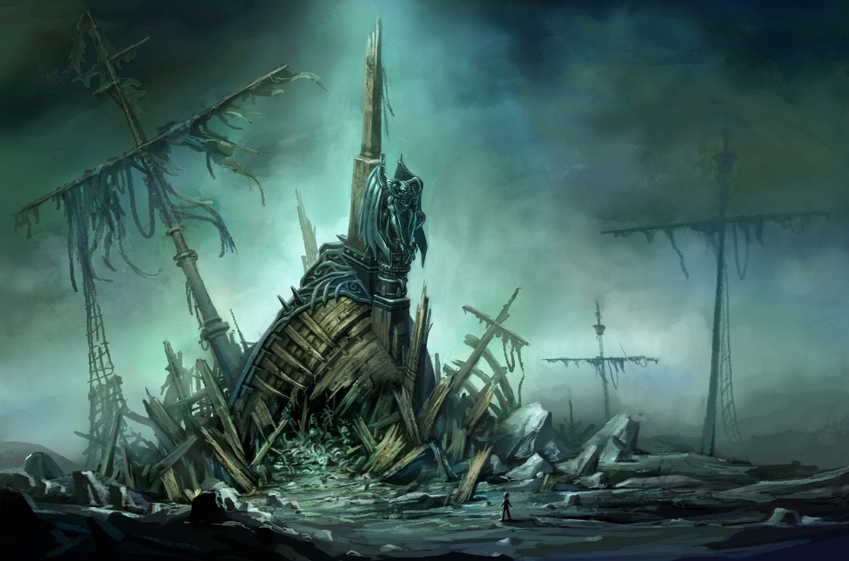
Dadwavers Planning Sheets
If you subscribe you will have access to over 60 of these planning sheets sorted into 3 categories:
Characters
Creatures
Landscapes

